Slide 1
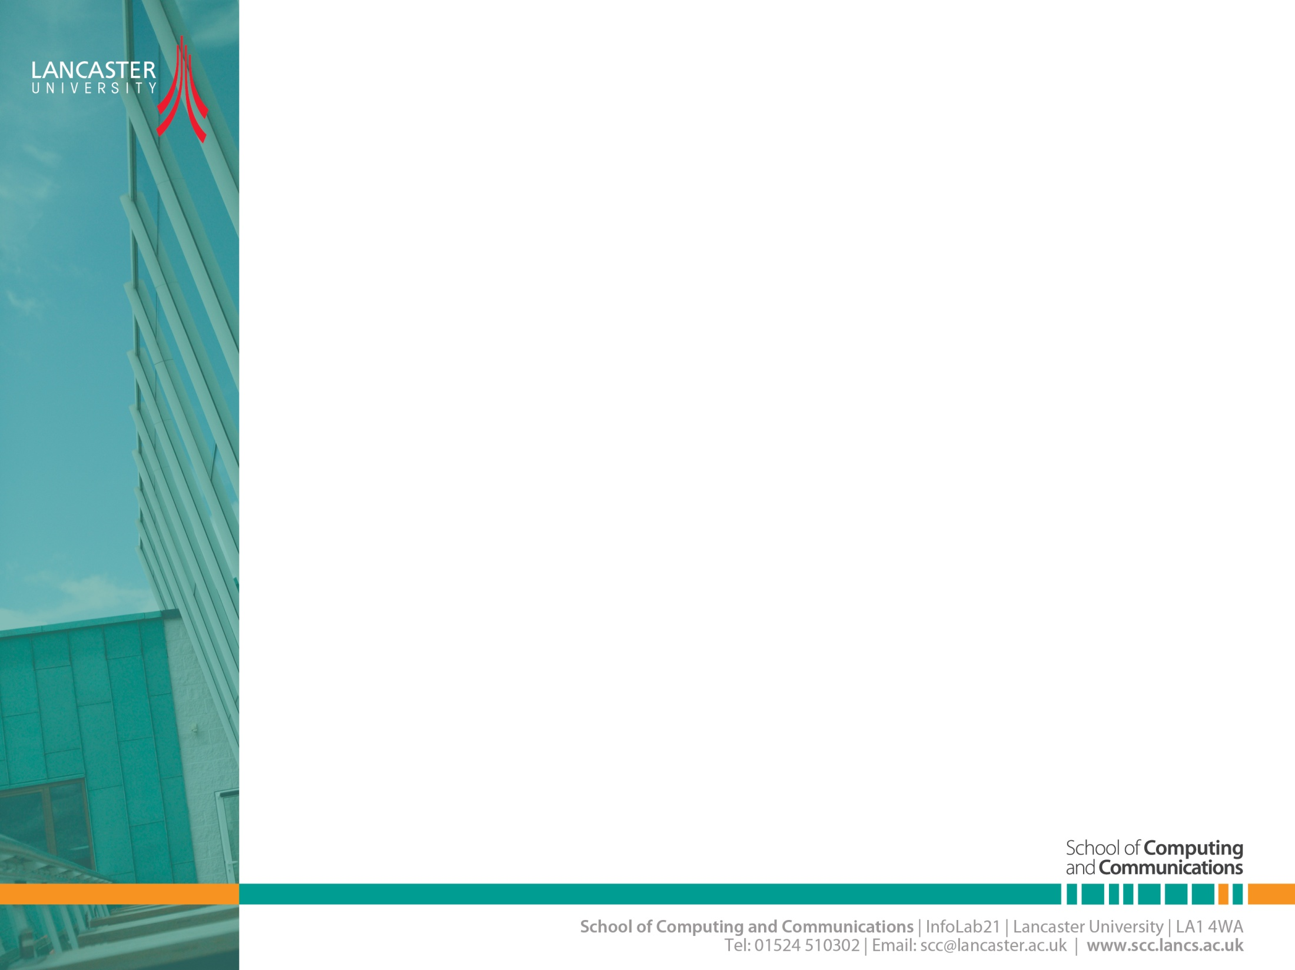

Multipath Propagation
CNSCC.405
Digital Signal Processing
Dr Muhammad Abrar (Dr. MAB)
m.abrar@lancaster.ac.uk
Spring Term 20223

Slide 2
FADING…
It is the rapid fluctuations of received signal strength over short time intervals and/or travel distances
Caused by interference from multiple copies of Tx signal arriving at Rx at slightly different times.
Three most important effects:
Rapid changes in signal strengths over small travel distances or short time periods.
Changes in the frequency of signals.
Multiple signals arriving at different times. When added together at the antenna, signals are spread out in time. This can cause a smearing of the signal and interference between bits that are received.

Slide 3
Multipath Propagation - Fading
a
b
No direct path
Diffracted
wave
Reflected
wave
a
Antenna
a
y = a + b
Antenna
y = 0
b
b
a & b are in phase
a & b are out of phase by π
Complete fading when
2πd/λ = nπ, d is the path difference

Slide 4
Even stationary Tx/Rx wireless links can experience fading: Why?
Due to the motion of objects (cars, people, trees, etc.) in surrounding environment off of which come the reflections.
Transmitting a short pulse over a
(i) frequency-selective (delay-spread) fading channel:
(ii) time-selective (Doppler-spread) fading channel:
Transmitted
Received
t
t
T_{p}
T_{p} + dt
Transmitted
Received
t
t
T_{p}
T_{p}
Notes:
For example, if an impulse is transmitted then it will be no longer a impulse when it is received at the other end, but it will become a pulse with spreading effect. The effect which makes this spreading of signal is known as Delay spread.

Slide 5
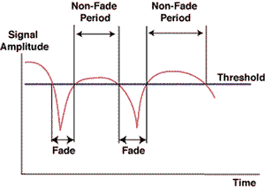
Figure Explaining Multi-path Fading

Slide 6
Fading
Large-scale fading (shadowing)
Long term variation in the mean signal level caused by the mobile unit moving into the shadow of surrounding objects
Small-scale fading (multipath)
Short term fluctuation in the signal amplitude caused by the local multipath

Slide 7
Shadow Fading
Long term shadow fading due to variations in radio signal power due to encounters with terrain obstructions such as hills or manmade structures such as buildings
The measured signal power differ substantially at different locations even though at the same radial distance from a transmitter
Represents the medium scale fluctuations of the radio signal strength over distances from tens to hundreds of meters

Slide 8
Shadow Fading
Many empirical studies demonstrate that the received mean power fluctuates about the average power with a log-normal distribution
Can be modelled by a gaussian random variable with standard deviation, δ

Slide 9
Small Scale Fading
A small scale fading that describes short-term, rapid amplitude fluctuations of the received signal during a short period of time
The actual power received over a much smaller distance vary considerably due to the destructive/constructive interference of multiple signals that follow multiple paths to the receiver
The direct ray is actually made up of many rays due to scattering multiple times by obstructions along its path, all travelling about the same distance
Each of these rays appearing at the receiver will differ randomly in amplitude and phase due to the scattering

Slide 10
Physical Factors Influencing Fading in Mobile Radio Channel (MRC)
1) Multipath Propagation
# and strength of multipath signals
time delay of signal arrival
large path length differences → large differences in delay between signals
urban area w/ many buildings distributed over large spatial scale
large # of strong multipath signals with only a few having a large time delay
suburb with nearby office park or shopping mall
moderate # of strong multipath signals with small to moderate delay times
rural → few multipath signals (LOS + ground reflection)

Slide 11
2) Speed of Mobile
relative motion between base station & mobile causes random frequency modulation due to Doppler shift (f_{d})
Different multipath components may have different frequency shifts.
3) Speed of Surrounding Objects
also influence Doppler shifts on multipath signals
dominates small-scale fading if speed of objects > mobile speed
otherwise ignored

Slide 12
4) Tx signal bandwidth (B_{s})
The mobile radio channel (MRC) is modeled as filter w/ specific bandwidth (BW)
The relationship between the signal BW & the MRC BW will affect fading rates and distortion, and so will determine:
a) if small-scale fading is significant
b) if time distortion of signal leads to inter-symbol interference (ISI)
An MRC can cause distortion/ISI or small-scale fading, or both.
But typically one or the other.

Slide 13
Small Scale Fading Classification
Flat fading
Multi path time delay
Frequency selective fading
Fading
Fast fading
Doppler spread
Slow fading

Slide 14
DELAY SPREAD
The different signal paths between Tx and a Rx corresponds to different transmission times. For an identical signal pulse from the Tx, multiple copies of the signals are received at the receiver at different moments.
The signal on the shortest path (typically LOS) reaches first than those on longer paths. The direct effect of these un-simultaneous arrivals of signal causes the spread of the original signal in time domain.
This spread is called the DELAY SPREAD.
Transmitted
Received
Delay spread is a measure of the multipath profile of a mobile communications channel.
t
t
T_{p}
T_{p} + dt
It is generally defined as the difference between the time of arrival of the earliest component (e.g., the line-of-sight wave if there exists) and the time of arrival of the latest multipath component.
Notes:
For example, if an impulse is transmitted then it will be no longer a impulse when it is received at the other end, but it will become a pulse with spreading effect. The effect which makes this spreading of signal is known as Delay spread.

Slide 15

COHERENCE BANDWIDTH
Corresponding to the concept of delay spread, there is a term called COHERENCE BANDWIDTH used to measure the up-limit bandwidth that can be transmitted for a channel to be free of ISI.
Coherence bandwidth is a statistical measurement of the range of frequencies over which the channel can be considered "flat“.
The approximate maximum bandwidth or frequency interval over which two frequencies of a signal are likely to experience comparable or correlated amplitude fading.
Coherence Bandwidth ~ (1/Maximum Delay Spread)

Slide 16
COHERENCE TIME
The coherence time is the characteristic time over which the channel gain does not change appreciably.
Time over which channel is constant is called coherence time.

Slide 17
Coherence BW (B_{c}) and Delay Spread ( )
The Fourier Transform of multipath delay shows frequency (spectral) characteristics of the MRC
B_{c} : statistical measure of frequency range where MRC response is flat
MRC response is flat = passes all frequencies with ≈ equal gain & linear phase
amplitudes of different frequency components are correlated
if two sinusoids have frequency separation greater than B_{c}, they are affected quite differently by the channel

Slide 18
amplitude correlation → multipath signals have close to the same amplitude → if they are then out-of-phase they have significant destructive interference with each other (deep fades)
so a flat fading channel is both “good” and “bad”
Good: The MRC is like a bandpass filter and passes signals without major attenuation from the channel.
Bad: Deep fading can occur.

Slide 19
so the coherence bandwidth is “the range of frequencies over which two frequency components have a strong potential for amplitude correlation.” (quote from textbook)

Slide 20
Estimates
0.9 correlation → Bc ≈ 1 / 50 (signals are 90% correlated with each other)
0.5 correlation → Bc ≈ 1 / 5 Which has a larger bandwidth and why?
specific channels require detailed analysis for a particular transmitted signal – these are just rough estimates

Slide 21
B_{c} and σ_{τ} are related quantities that characterize time-varying nature of the MRC for multipath interference from frequency & time domain perspectives
A channel that is not a flat fading channel is called frequency selective fading because different frequencies within a signal are attenuated differently by the MRC.
Note: The definition of flat or frequency selective fading is defined with respect to the bandwidth of the signal that is being transmitted.

Slide 22
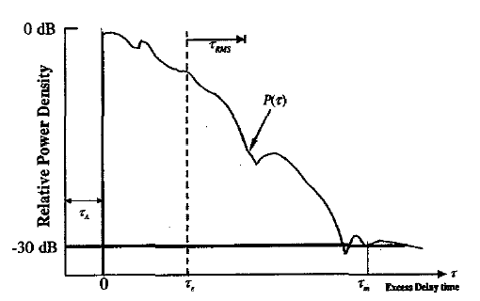
Multipath Delay Spread
First-arrival delay (τ_{A})
Mean excess delay

Slide 23
Effects of delay spread:
It causes-
INTER SYMBOL INTERFERENCE (ISI)
if the bandwidth of a transmitter signal is less than the channel coherence bandwidth, the channel shows flat fading to be free of ISI.
otherwise, the channel shows frequency selective fading and may suffer from ISI.
Delay spread varies with the terrain with typical values for rural, urban and suburban areas:
≈
μ
(
)
≈
3
.
0
μ
s
(
urban
)
≈
0
.
5
μ
s
(
suburban
)
0
.
2
s
rural

Slide 24
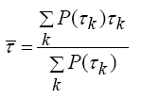

Time Dispersion Parameters
“excess delay” : all values computed relative to the time of first signal arrival τ_{o}
mean excess delay →
RMS delay spread →
where Avg ( τ²) is the same computation as above as used for except that
A simple way to explain this is “the range of time within which most of the delayed signals arrive”

Slide 25
τ and σ_{τ} provide a measure of propagation delay of interfering signals
Then give an indication of how time smearing might occur for the signal.
A small σ_{τ} is desired.
The noise threshold is used to differentiate between received multipath components and thermal noise

Slide 26
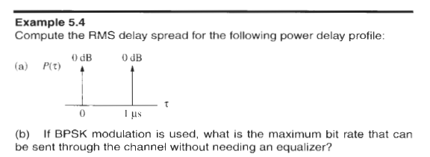

Slide 27
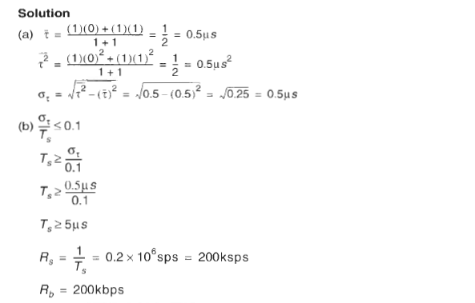

Slide 28
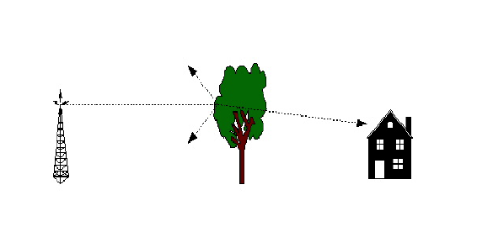
Flat Fading
Flat Fading is caused by absorbers between the two antennas and is countered by antenna placement and transmit power level.
Bandwidth of signal < bandwidth of channel.
Delay Spread is less than the symbol period.

Slide 29
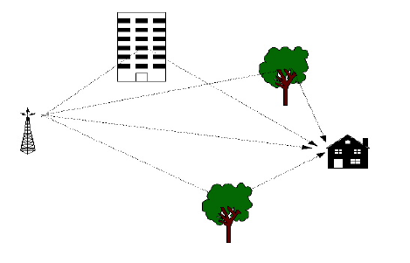
Frequency Selective Fading
Frequency selective fading is caused by the reflectors between the transmitter and the receiver creating multi-path effects.
Bandwidth of signal > bandwidth of channel.
Delay Spread is greater than the symbol period

Slide 30
DOPPLER SPREAD
Defn : Time varying fading due to the motion of a scatter or the motion of the transmitter or receiver or both results in Doppler spread.
It is caused by TIME SELECTIVE FADING.
i.e for a particular instance of time channel behaves as a fading channel and for rest it behaves as FLAT channel.
TYPES OF FADING ON BASIS OF DOPPLER SPREAD:
Fast fading – channel impulse response changes rapidly within the symbol duration
Slow fading – channel impulse response changes at a rate much slower than the transmitted symbol bandwidth

Slide 31
EFFECT OF MOVEMENT
Here is a plot of the magnitude of fading as a function of time and frequency.
In this case, the channel does not change much over time. It is a slowly fading channel.

Slide 32
EFFECT OF MOVEMENT
Here is a plot of the magnitude of fading as a function of time and frequency.
In this case, the channel does not vary with frequency, it only varies over time.

Slide 33
EFFECT OF MOVEMENT
Here is a plot of the magnitude of fading as a function of time and frequency.
In this case, the channel varies both with frequency and time.

Slide 34

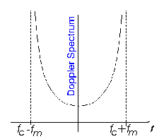
Doppler Effect
When the receiver or transmitter are moving, the frequency is shifted by Δf = v/λ cos(θ), v is velocity and λ is wavelength
θ
c is the speed of light.
If the the signal is sent at fc and passed through a fading channel, the spectrum of the received signal is:
Thus, not only one frequency is received, but many.

Slide 35
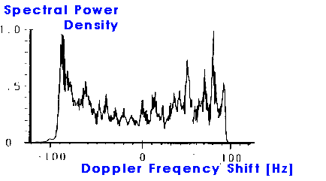
If a sinusoidal signal is transmitted (represented by a spectral line in the frequency domain), after transmission over a fading channel, we will receive a power spectrum that is spread according to the image.
Figure: Measured Doppler spread at 1800 MHz. Doppler spread = 60.3 Hz
The frequency range where the power spectrum is nonzero defines the Doppler spread.

Slide 36
The Doppler frequency
The received signal frequency
When θ = 0º (mobile moving away from the transmitter)
When θ = 90º (I.e. mobile circling around)
When θ = 180º (mobile moving towards the transmitter)

Slide 37
Doppler spread and coherence time
Doppler spread and coherence time (T_{c}) are inversely proportional
f_{rms} is the rms value of maximum doppler shift
Given as,
For 0.5 correlation

Slide 38
Doppler Effect
To mitigate the Doppler effect:
Use low frequencies
Transmit in bursts so the channel is constant during the burst.
Include training sequences on each frame so the channel can be re-estimated for each transmission.
Do move – indoor use only

Slide 39
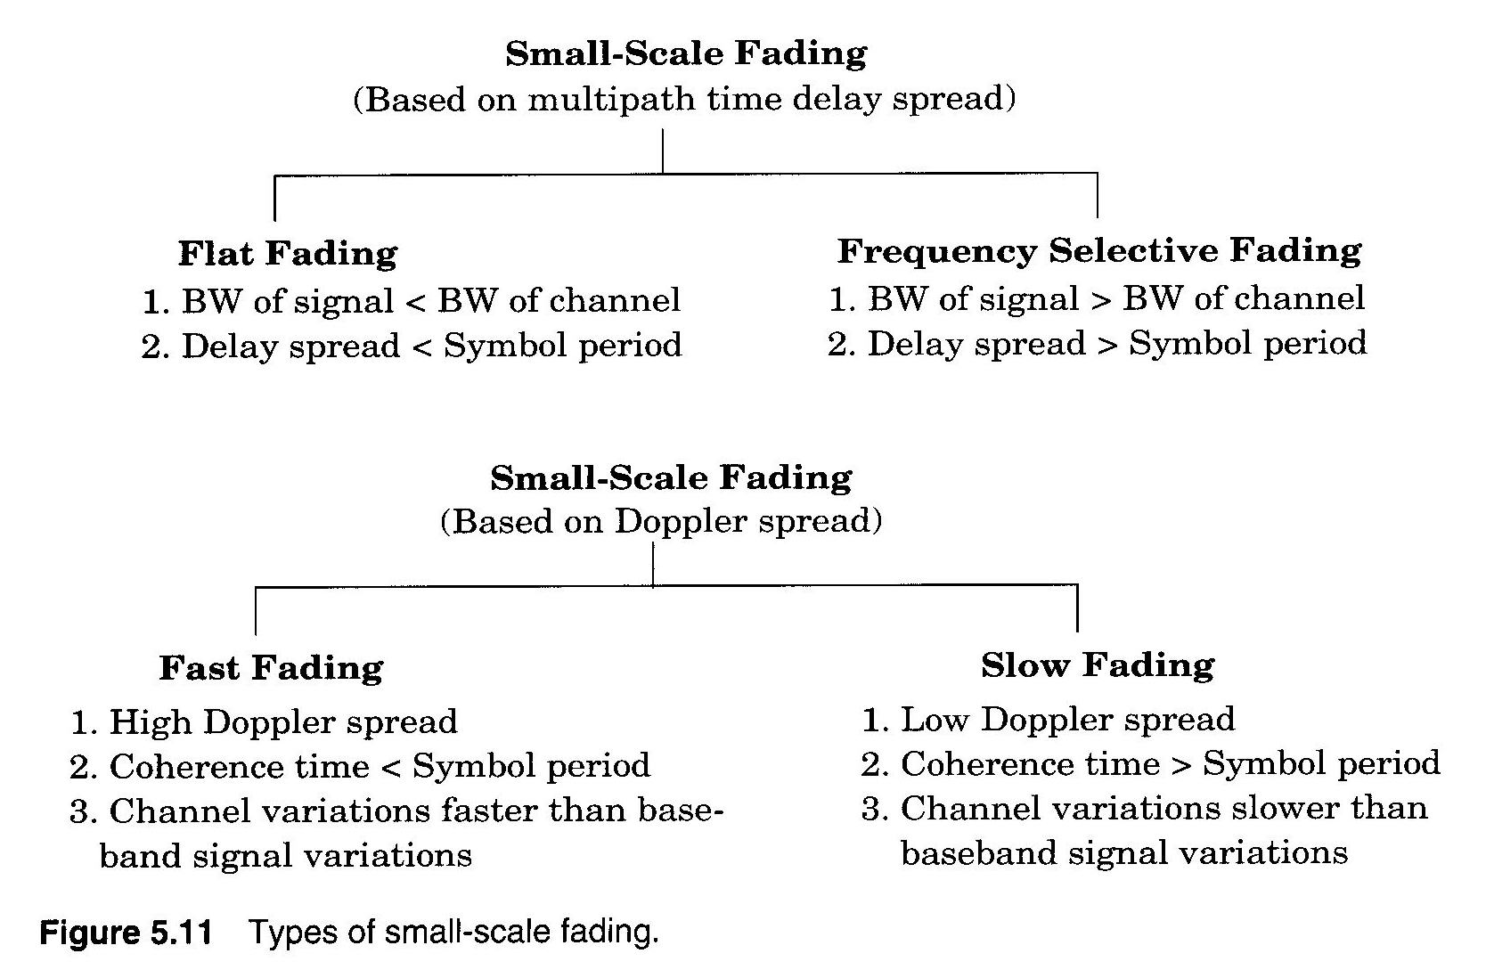
illustrates types of small-scale fading

Slide 40
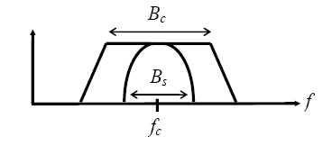
Fading due to Multipath Delay
A）Flat Fading → B_{s} << B_{c} or T_{s} >>
signal fits easily within the bandwidth of the channel
channel BW >> signal BW
most commonly occurring type of fading

Slide 41
spectral properties of Tx signal are preserved
signal is called a narrowband channel, since the bandwidth of the signal is narrow with respect to the channel bandwidth
signal is not distorted
What does T_{s} >> mean??
all multipath signals arrive at mobile Rx during 1 symbol period
∴ Little intersymbol interference occurs (no multipath components arrive late to interfere with the next symbol)

Slide 42
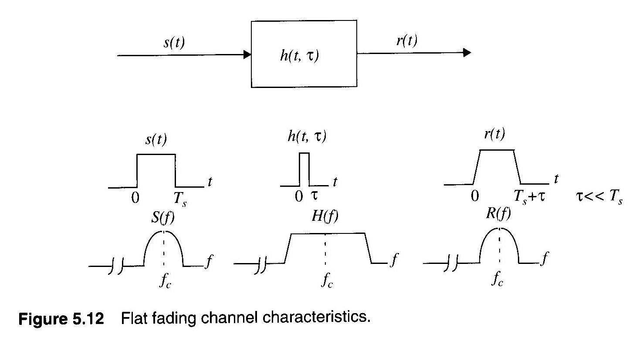

Slide 43
flat fading is generally considered desirable
Even though fading in amplitude occurs, the signal is not distorted
Forward link → can increase mobile Rx gain (automatic gain control)
Reverse link → can increase mobile Tx power (power control)
Can use diversity techniques

Slide 44
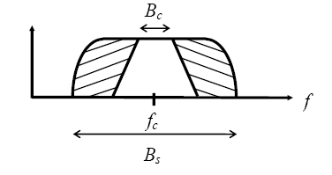
B) Frequency Selective Fading → B_{s} > B_{c} or T_{s} <
B_{s} > B_{c} → certain frequency components of the signal are attenuated much more than others

Slide 45
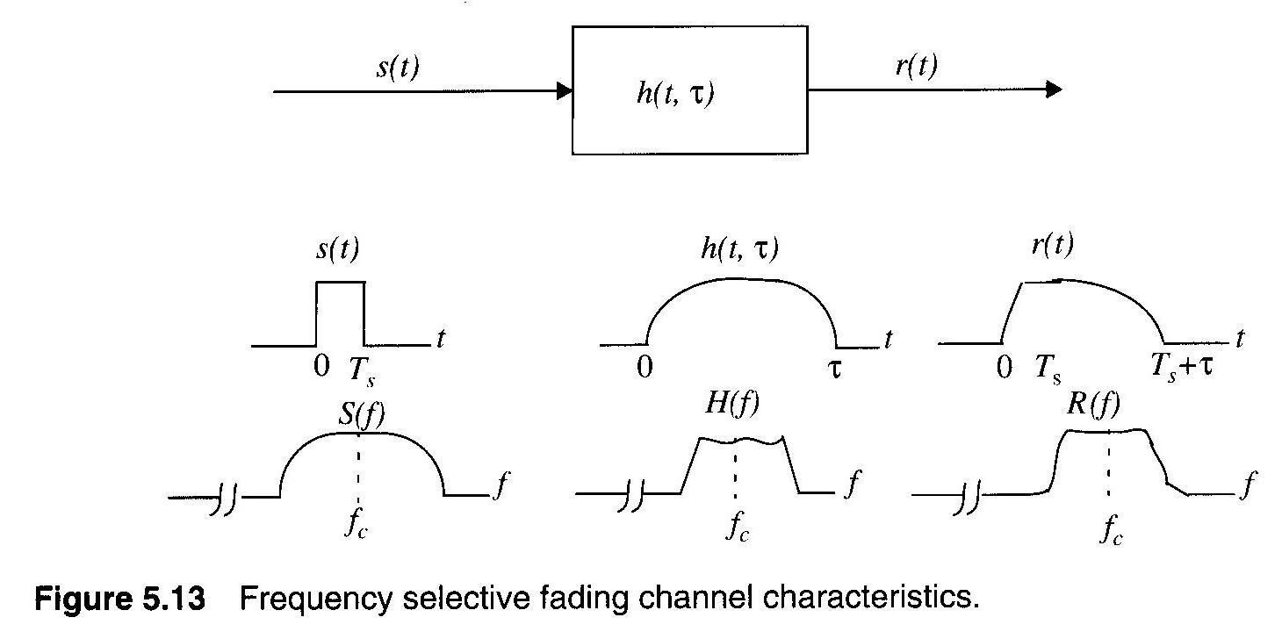

Slide 46
Ts < σ_{τ} → delayed versions of Tx signal arrive during different symbol periods
e.g. receiving an LOS → “1” & multipath “0” (from prior symbol!)
This results in intersymbol interference (ISI)
Undesirable
it is very difficult to predict mobile Rx performance with frequency selective channels

Slide 47
2) Fading due to Doppler Spread
Caused by motion of Tx and Rx and reflection sources.
A) Fast Fading → B_{s} < B_{D} or T_{s} > T_{c}
B_{s} < B_{D}
Doppler shifts significantly alter spectral BW of TX signal
signal “spreading”
Ts > Tc
MRC changes within 1 symbol period
rapid amplitude fluctuations
uncommon in most digital communication systems

Slide 48
B) Slow Fading → T_{s} << T_{c} or B_{s} >> B_{D}
MRC constant over many symbol periods
slow amplitude fluctuations
for v = 60 mph @ f_{c} = 2 GHz → B_{D} = 178 Hz
∴ B_{s} ≈ 2 kHz >> B_{D}
B_{s} almost always >> B_{D} for most applications

